Slide 1


Detecting Stock Market Manipulation
Using Supervised Learning Algorithms
이여진 연구원
2017년 05월 24일

Slide 2
Paper Info
Title :
Detecting Stock Market Manipulation using Supervised Learning Algorithms
2. Authors : Koosha Golmohammandi, Osmar R. Zaiane
3. Published in : Data Science and Advanced Analytics (DSAA)
4. Published on : 2014

Slide 3
Abstract
This paper use supervised learning algorithms to identify suspicious transactions in relation to *market manipulation in stock market.
Using a case study of manipulated stocks during 2003.
Adopting CART, conditional inference trees, C5.0, Random Forest, Naïve Bayes, Neural Networks, SVM and KNN for classification of manipulated samples (8).
Naïve Bayes outperform other learning methods.
* Market manipulation definition (in this paper)
: market manipulation involves international attempts to deceive investors by affecting or controlling the price of a security or interfering with the fair market to gain profit.

Slide 4
Introduction
Securities fraud is divided into 5 categories (FBI report 2010)
High yield investment fraud
Broker embezzlement
Late-day trading
Market manipulation
Market manipulation is divided into 3 groups
Marking the close
purchasing or selling a security at the very end of the training day,
at a significantly higher price than the security’s current traded price,
thus making it appear to be higher value than it actually is.
Wash trades
purchasing or selling a security simultaneously,
to artificially increase trading volume,
giving the impression that the security is more in demand than it actually is.
Cornering the market
acquiring a lot of shares of a particular security type,
to control its price.

Slide 5
Dataset
Dataset(named manipulated cases dataset) is based on market manipulation cases pursued by the US Securities and Exchange Commission(SEC) between January and December of 2003. <positive samples, manipulated cases>
In addition, the * Standard and Poor’s COMPUSTAT database was used to 1) provide supplementary information and 2) include non-manipulated stocks. <negative samples, normal cases>
* Standard and Poor’s COMPUSTAT database
Standard and Poor is an American financial services and credit rating agency that has been publishing financial research and analysis on stocks and bonds.
< Dataset >
Entire data : 175,738 (hourly transactional data) of 64 issuers
Period : between January and December of 2003
Category of issuers (64) : 8 manipulated stocks, 56 non-manipulated stocks (25 similar stocks, 31 dissimilar stocks)
manipulated stocks (positive samples)
similar stocks (negative samples) : stocks similar to manipulated stocks (similarity based on market capitalization, beta, and industry sector)
dissimilar stocks (negative samples) : as a control for comparison of manipulated and non-manipulated cases with similar characteristics.

Slide 6
Dataset
< Dataset >
Features : 69 data attributes which include price change, volumes etc.
The number of samples for training : 27,025 (approximately 15%)
The number of samples for testing : 148,713 (approximately 85%)

Slide 7
Methodology (Supervised Algorithms)
CART (Classification and Regression Tree)
C5.0
CTree (Conditional Inference Trees)
Naïve Bayes
Neural Networks
Support Vector Machines
K-Nearest Neighbor
* CART, C5.0, CTree are type of decision tree algorithms respectively.
< Classification >
- predicting the class of Y ∈ {0,1} based on a feature set of X1, X2, … , Xd.
Y = 0 (negative, non-manipulated sample)
Y = 1 (positive, manipulated sample)

Slide 8



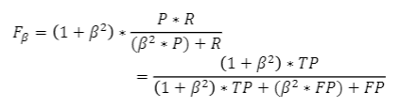

Performance Evaluation
Measurement
Sensitivity (Recall) : measures the performance of the model in correctly classifying manipulated samples as positive. (a.k.a true positive rate)
Specificity : measures the performance of the model in correctly classifying non-manipulated samples as negative.
(a.k.a true negative rate)
Accuracy
F2 measure :
the harmonic mean of precision and
sensitivity.
TP (True Positive) :
The number of manipulated cases classified as positive
FP (False Positive) :
The number of non-manipulated cases classified as positive
TN (True Negative) :
The number of non-manipulated cases classified as negative
FN (False Negative) :
The number of manipulated cases classified as negative
$β$ : 2

Slide 9
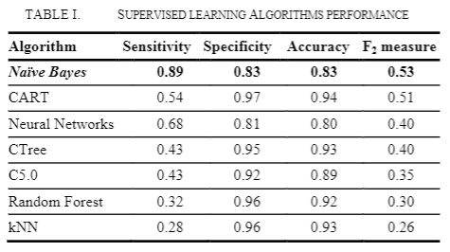
Performance Evaluation
2. Performance Evaluation

Slide 10
감사합니다.

